Slide 1



IoT-Enabled Non-Invasive Methods for Early Detection of Cardiotoxicity
Mentor:
Team Members:
Dr.R.Kathiroli
Aishwarya Devi R (2021503501)
Surya Raj M (2021503701)
Sridhar P (2021503709)

Slide 2


Cardio Vascular Diseases (CVDs) claim millions of lives annually, making them the top global cause of death.
Timely detection and intervention are vital for better outcomes and lower mortality rates.
Yet, current cardiotoxicity detection methods are often invasive and lack real-time monitoring.
PROBLEM STATEMENT

Slide 3
To detect Arrythmia from the abnormalities in ECG.
To develop a non-invasive tool using IoT-based cardiac biosensors and Deep Learning (DL) algorithms to predict cTn levels.
To enable real-time predictions of heart functions for timely interventions and improved healthcare outcomes.
To integrate Explainable Artificial Intelligence (XAI) techniques for interpretation and explainability of the model's predictions.
To integrate the trained model into an IoT wearable device for continuous monitoring and early detection of cardiovascular abnormalities.
OBJECTIVE

Slide 4
Literature Survey:
Sl.No | Paper Title | Methodology | Limitations
1. | IoT Based Smart Monitoring of Patients with Acute Heart Failure Year: 2022 Journal: Sensors | Classification of heart failure using 13 features, employing various models including CNN, RNN, MLP, and LSTM. CNN with an accuracy of 92.89%. IoT sensors for monitoring heart rate, blood pressure (BP), temperature and ECG signals. | Dataset is highly imbalanced. Model is not trained well on minority classes.
2. | Arrhythmia detection using deep convolutional neural network with long duration ECG signals Year: 2018 Journal: Computers in Biology and Medicine | Classification of cardiac arrythmia into 17 classes, considering long duration ECG signal of 10s. 1D CNN with 16 layer deep, achieving accuracy of 91.33% and classification time of 0.015 s. Reduction of computational complexity. | Small no of ECG signal fragments are analysed. No possibility of classifying fragments of ECG signal containing more than one class.

Slide 5
3. | An IoT Framework for Heart Disease Prediction Based on MDCNN Classifier Year: 2020 Journal: IEEE Access | Modified Deep CNN for classification and integrates the Elephant Herd Optimization Algorithm (AEHO). Feature selection by Cuttlefish Optimization Algorithm. Integration of microcontroller and LoRa Omron HeartGuide smartwatch for blood pressure measurement and the AD8232 for ECG measurement. | Actual data for serum cholesterol, chest pain and glucose level are not used.
4. | A single-lead ECG based cardiotoxicity detection in patients on polychemotherapy Year: 2024 Journal: IJC Heart & Vasculature | Single-lead ECG to detect cardiotoxicity in cancer patients with minimal cardiovascular diseases . Utilizes the CardioQvark mobile phone cover with an integrated ECG sensor for signal detection. Detection focuses on identifying left ventricular diastolic dysfunction, atrial fibrillation, and QTc prolongation. | Sample did not include patients with intermediate and low LVEF

Slide 6
5. | A Wearable ECG Monitor for Deep Learning Based Real-Time Cardiovascular Disease Detection Year: 2022 Journal: arXiv | Wearable ECG monitoring system, consists of an integrated ECG sensor where ECG data is collected, converted to digital signals using ADC. The ECG signals are wirelessly transmitted to a mobile device via Bluetooth. Preprocessing by sliding window and denoising using Discrete Wavelet Transform (DWT). Confidence level-based training approach with ResNet, achieving an accuracy of 90.2%. | Relies heavily on the optimal selection of the confidence level, which may vary based on the dataset and label quality
6. | Predicting cardiovascular events with deep learning approach in the context of the internet of things Year: 2021 Journal: Neural Computing & Applications | The approach utilized is LSTM-DBN, achieving an accuracy of 88.42%. LSTM for learning long-term dependencies with DBN for feature selection. Stochastic Gradient Descent (SGD) for optimizing the loss function. Comparative analysis is conducted with four other DL approaches (CNN, RNN, GRU, Ensemble) and four ML approaches (MLP, LR, SVM, RF). | High computational efficiency and memory is required for DBN as compared to other algorithms.

Slide 7
7. | IoT-Based System for Heart Monitoring and Arrhythmia Detection Using Machine Learning Year: 2023 Journal: J Healthc Eng | Remote monitoring of cardiac signals through the integration of IoT and machine learning techniques. Components include Polar H10 ECG sensor, a CRUD REST API, a Monitoring GUI, an Arrhythmia Detection Component. Utilizes MQTT protocol for communication. Classification uses k-nearest neighbors with accuracy of 97%. | Lack of discussion on robustness to noise and variability in ECG signals.
8. | An Efficient IoT-Based Platform for Remote Real-Time Cardiac Activity Monitoring Year: 2020 Journal: IEEE Transactions On Consumer Electronics | Real-time monitoring of ECG signals by filtering and localizing R-peaks using the Pan Tompkin’s algorithm. Feature extraction using FFT and DWT. Classification through twin support vector machines (TSVM) tuned by Particle Swarm Optimization (PSO). The prototype is implemented on a microcontroller platform equipped with a Wi-Fi module for data transmission and connectivity. | More specific selection of features based on R-wave morphology. Lacks the discussion about power consumption of the platform.

Slide 8
9. | Deep Learning-Based Data Augmentation and Model Fusion for Automatic Arrhythmia Identification and Classification Algorithms Year: 2022 Journal: Computational Intelligence and Neuroscience | ECG-GAN for data augmentation and the ResNet BiLSTM-Attention for classification achieving accuracy of 99.4%. ResNet is used for local feature extraction and BiLSTM for global feature extraction. DWT is used for denoising and QRS waveform detected using Pan Tompkin’s algorithm. | Integrating ResNet and BiLSTM models introduces complexity to the classification process. Optimization of hyperparameters is not performed.
10. | Detection of Cardiovascular Diseases in ECG Images Using Machine Learning and Deep Learning Methods Year: 2023 Journal: IEEE Transactions On Artificial Intelligence | Lightweight CNN model for predicting four major cardiac abnormalities using ECG images. Transfer learning using SqueezeNet and AlexNet and proposes a new CNN architecture for cardiac abnormality prediction achieving 99.79% accuracy. The pretrained models and the proposed CNN model are used as feature extraction tools. | Training and testing time for SquuezeNet based algorithm is longer. Optimization algorithms are not used.

Slide 9
PROPOSED SYSTEM​: ​
M1: Preprocessing of ECG images
M2: Model training using CNN
M3: Model training using MobileNet
M4: Model training using VGG
M5: Model training using ResNet
M6:Ensemble voting algorithm
M7: Integration of Explainable AI using Grad CAM
M8: IoT device integration and web product

Slide 10
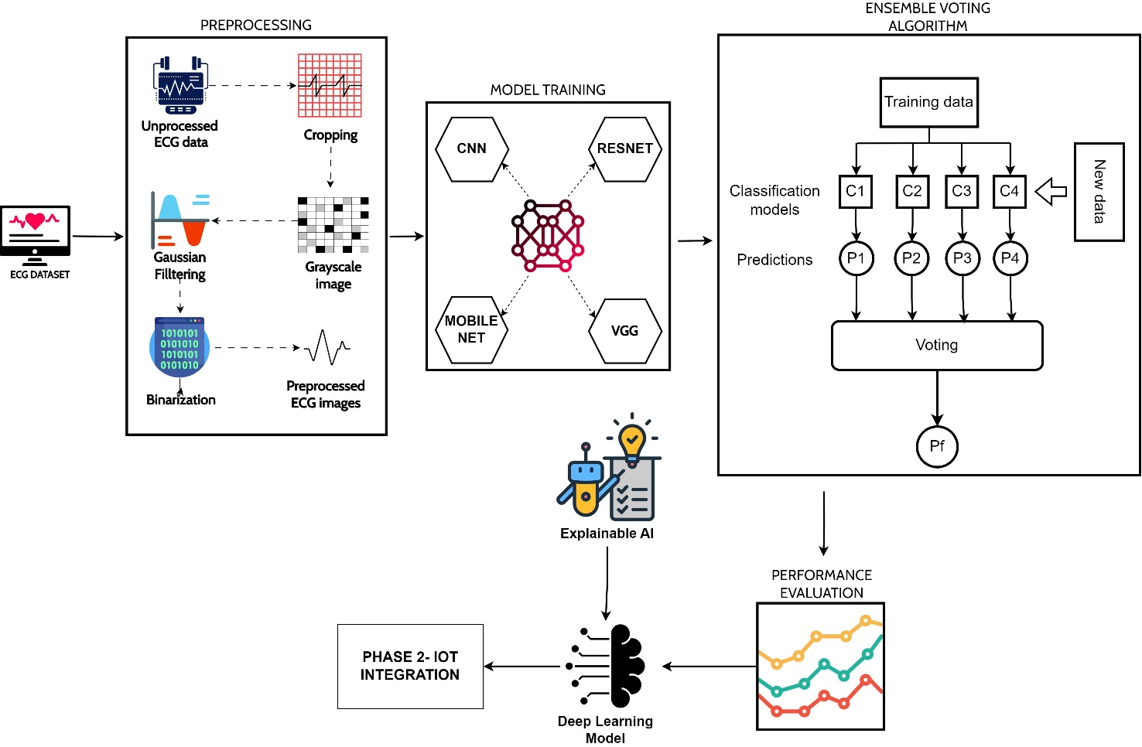
Fig. 1. SYSTEM MODEL

Slide 11

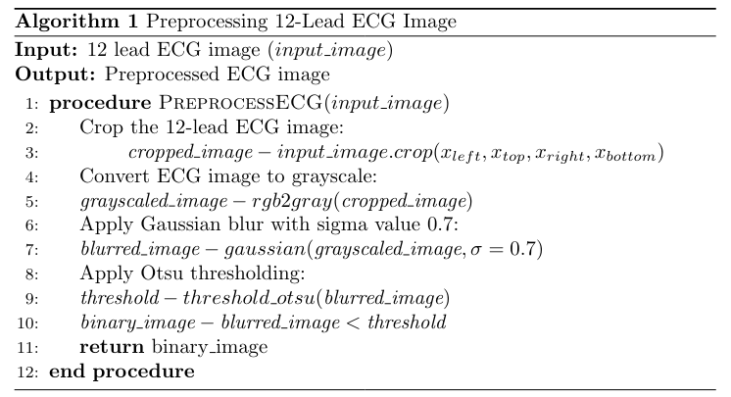
ALGORITHM FOR PREPROCESSING:

Slide 12
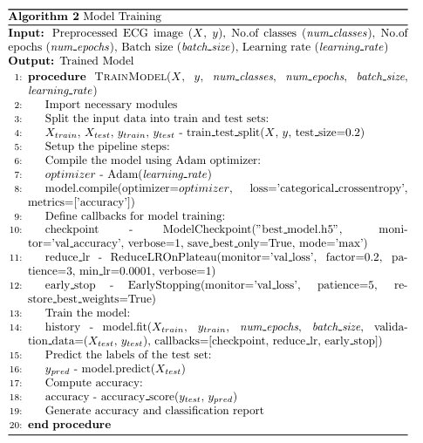
ALGORITHM FOR MODEL TRAINING:

Slide 13
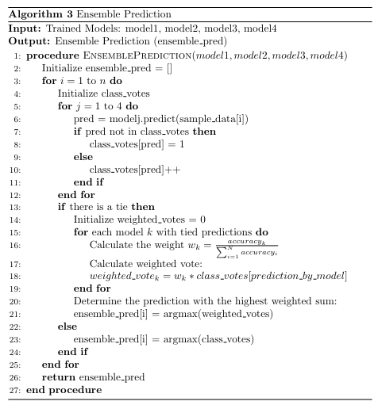
ALGORITHM FOR ENSEMBLE PREDICTION:

Slide 14
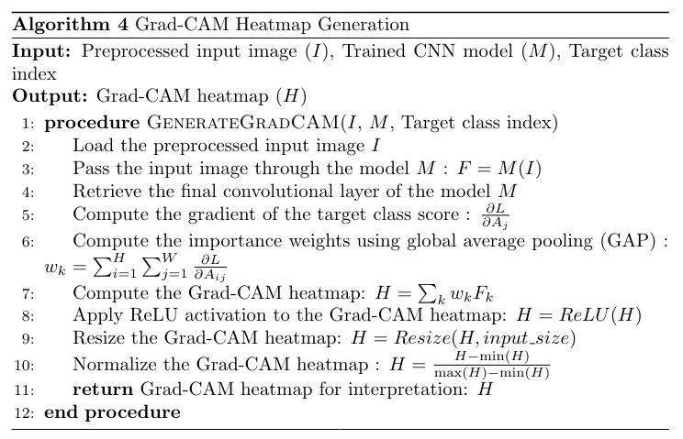
ALGORITHM FOR VISUALIZATION USING GRAD CAM:

Slide 15
PERFORMANCE EVALUATION METRICS
ROC curve:
Evaluates a classifier's performance by plotting the trade-off between True Positive Rate and False Positive Rate.
Confusion matrix​
Summarizes model predictions, showing correct and incorrect classifications.
Accuracy = (TP + TN) / (TP + TN + FP + FN)​
Measures the overall correctness of the classification model.
Precision = TP / (TP + FP)​
Reflects the accuracy of positive predictions made by the model.
Recall=TP / (TP + FN)​
Measures the ability of the model to capture all positive instances.
Specificity=TN / (TN + FP)​
Measures the ability of the model to correctly identify negative instances.
F1-score= 2 × Precision × Recall / Precision + Recall​
provides a single metric that balances both precision and recall, especially useful when dealing with imbalanced classes.

Slide 16
DATASET DESCRIPTION:
ECG images dataset of Cardiac Patients created under the auspices of Ch. Pervaiz Elahi Institute of Cardiology Multan, Pakistan that aims to help the scientific community for conducting the research for Cardiovascular diseases.
CLASSES:
ECG images dataset of CECG Images of Myocardial Infarction Patients
ECG Images of Patient that have abnormal heartbeat
ECG Images of Patient that have History of MI
Normal Person ECG Images

Slide 17
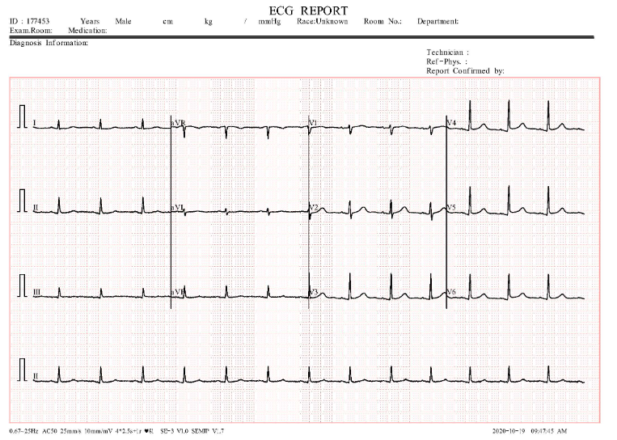
SAMPLE DATA

Slide 18
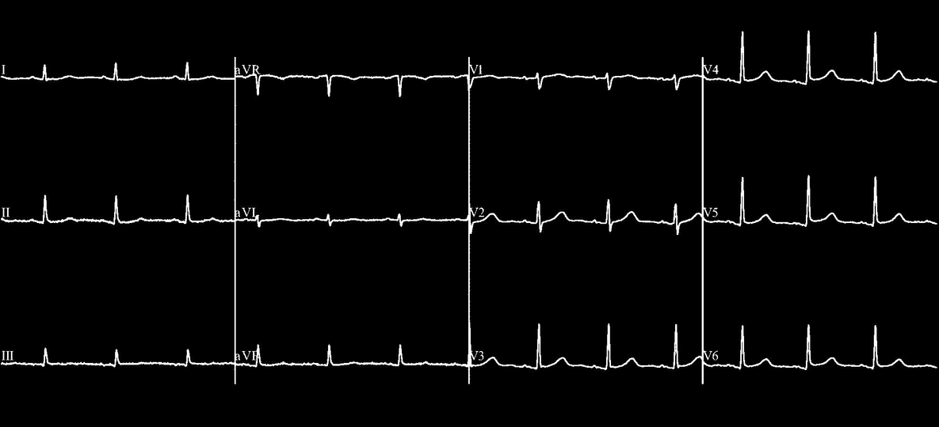
PREPROCESSESING
BEFORE
AFTER

Slide 19
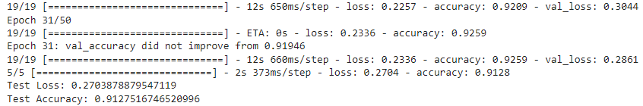
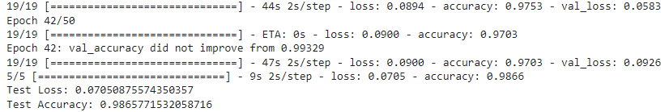
MODEL TRAINING:
CNN:
MOBILENET:

Slide 20
REFERENCE
[1] Umer M, Sadiq S, Karamti H, Karamti W, Majeed R, Nappi M. IoT Based Smart Monitoring of Patients with Acute Heart Failure. Sensors (Basel). 2022 Mar 22;22(7):2431. doi: 10.3390/s22072431. PMID: 35408045; PMCID: PMC9003513.
[2] Yıldırım Ö, Pławiak P, Tan RS, Acharya UR. Arrhythmia detection using deep convolutional neural network with long duration ECG signals. Comput Biol Med. 2018 Nov 1;102:411-420. doi: 10.1016/j.compbiomed.2018.09.009. Epub 2018 Sep 15. PMID: 30245122.
[3] M. A. Khan, "An IoT Framework for Heart Disease Prediction Based on MDCNN Classifier," in IEEE Access, vol. 8, pp. 34717-34727, 2020, doi: 10.1109/ACCESS.2020.2974687.
[4] Mesitskaya DF, Fashafsha ZZA, Poltavskaya MG, Andreev DA, Levshina AR, Sultygova EA, Gognieva D, Chomakhidze P, Kuznetsova N, Suvorov A, Marina I S, Poddubskaya E, Novikova A, Bykova A, Kopylov P. A single-lead ECG based cardiotoxicity detection in patients on polychemotherapy. Int J Cardiol Heart Vasc. 2024 Jan 20;50:101336. doi: 10.1016/j.ijcha.2024.101336. PMID: 38304727; PMCID: PMC10831811.
[5] Wang, Peng & Lin, Zihuai & Yan, Xucun & Chen, Zijiao & Ding, Ming & Song, Yang & Meng, Lu. (2022). A Wearable ECG Monitor for Deep Learning Based RealTime Cardiovascular Disease Detection. arXiv:2201.10083.

Slide 21
REFERENCE
[6] Dami, S., Yahaghizadeh, M. Predicting cardiovascular events with deep learning approach in the context of the internet of things. Neural Comput & Applic 33, 7979– 7996 (2021).
[7] Cañón-Clavijo RE, Montenegro-Marin CE, Gaona-Garcia PA, Ortiz-Guzmán J. IoT Based System for Heart Monitoring and Arrhythmia Detection Using Machine Learning. J Healthc Eng. 2023 Feb 8;2023:6401673. doi: 10.1155/2023/6401673. PMID: 36818385; PMCID: PMC9931473.
[8] S. Raj, "An Efficient IoT-Based Platform for Remote Real-Time Cardiac Activity Monitoring," in IEEE Transactions on Consumer Electronics, vol. 66, no. 2, pp. 106- 114, May 2020, doi: 10.1109/TCE.2020.2981511.
[9] Ma S, Cui J, Xiao W, Liu L. Deep Learning-Based Data Augmentation and Model Fusion for Automatic Arrhythmia Identification and Classification Algorithms. Comput Intell Neurosci. 2022 Aug 11;2022:1577778. doi: 10.1155/2022/1577778. PMID: 35990162; PMCID: PMC9388256.
[10] M. B. Abubaker and B. Babayiğit, "Detection of Cardiovascular Diseases in ECG Images Using Machine Learning and Deep Learning Methods," in IEEE Transactions on Artificial Intelligence, vol. 4, no. 2, pp. 373-382, April 2023 doi: 10.1109/TAI.2022.3159505.

Slide 22
REFERENCE
[11] Dami, S., Yahaghizadeh, M. Predicting cardiovascular events with deep learning approach in the context of the internet of things. Neural Comput & Applic 33, 7979–7996 (2021).
[12] Humayra Afrin, Christiancel Joseph Salazar, Mohsin Kazi, Syed Rizwan Ahamad, Majed Alharbi, Md Nurunnabi, Methods of screening, monitoring and management of cardiac toxicity induced by chemotherapeutics, Chinese Chemical Letters, Volume 33, Issue 6, 2022, Pages 2773-2782, ISSN 1001-8417.
[13] Kinoshita T, Yuzawa H, Natori K, Wada R, Yao S, Yano K, Akitsu K, Koike H, Shinohara M, Fujino T, Shimada H, Ikeda T. Early electrocardiographic indices for predicting chronic doxorubicin-induced cardiotoxicity. J Cardiol. 2021 Apr;77(4):388-394. doi: 10.1016/j.jjcc.2020.10.007. Epub 2020 Nov 16. PMID: 33214049.
[14] Jian Lin, Rumin Fu, Xinxiang Zhong, Peng Yu, Guoxin Tan, Wei Li, Huan Zhang, Yangfan Li, Lei Zhou, Chengyun Ning, Wearable sensors and devices for real-time cardiovascular disease monitoring, Cell Reports Physical Science, Volume 2, Issue 8, 2021, 100541, ISSN 2666-3864.

Slide 23
REFERENCE
[15] N. E. Oyunbaatar, D. S. Kim, E. S. Kim, B. K. Lee and D. W. Lee, "Cardiac toxicity screening using polymeric cantilever integrated with cell stimulators," 2017 IEEE 30th International Conference on Micro Electro Mechanical Systems (MEMS), Las Vegas, NV, USA, 2017, pp. 418-421, doi: 10.1109/MEMSYS.2017.7863431.
[16] Sophia Nazir, Rabail Azhar Iqbal, Biosensor for rapid and accurate detection of cardiovascular biomarkers: Progress and prospects in biosensors, Biosensors and Bioelectronics: X, Volume 14, 2023, 100388, ISSN 2590-1370.
[17] Martinez DS, Noseworthy PA, Akbilgic O, Herrmann J, Ruddy KJ, Hamid A, Maddula R, Singh A, Davis R, Gunturkun F, Jefferies JL, Brown SA. Artificial intelligence opportunities in cardio-oncology: Overview with spotlight on electrocardiography. Am Heart J Plus. 2022 Mar;15:100129. doi: 10.1016/j.ahjo.2022.100129. Epub 2022 Apr 1. PMID: 35721662; PMCID: PMC9202996.
[18] Baghdadi, N.A., Farghaly Abdelaliem, S.M., Malki, A. et al. Advanced machine learning techniques for cardiovascular disease early detection and diagnosis. J Big Data 10, 144 (2023).

Slide 24
REFERENCE
[19] Karanasiou G, Koumakis L, Sfakianakis S, Manikis G, Kalliatakis G, Antoniades A, Lakkas L, Mauri D, Cipolla C, Mazzocco K, Papakonstantinou A, Filippatos G, Constantinidou A, Seruga B, Conti C, Bucur A, Pacella E, Marias K, Tsiknakis M, Fotiadis DI. CARDIOCARE: An integrated platform for the management of elderly multimorbid patients with breast cancer therapy induced cardiac toxicity. Annu Int Conf IEEE Eng Med Biol Soc. 2023 Jul;2023:1-4. doi: 10.1109/EMBC40787.2023.10340747. PMID: 38083750.
[20] Zahra Ebrahimi, Mohammad Loni, Masoud Daneshtalab, Arash Gharehbaghi, A review on deep learning methods for ECG arrhythmia classification, Expert Systems with Applications: X, Volume 7, 2020, 100033, ISSN 2590-1885,

Slide 25
THANK YOU...

Slide 28
